Slide 1
Lab4: All Joins

Slide 2
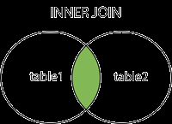
INNER JOIN
Returns records that have matching values in both tables

Slide 3
INNER JOIN SYNTAX
SELECT column_name(s)
FROM table1
INNER JOIN table2
ON table1.column_name = table2.column_name;

Slide 4
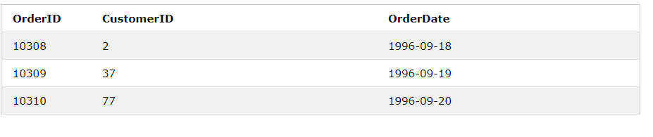
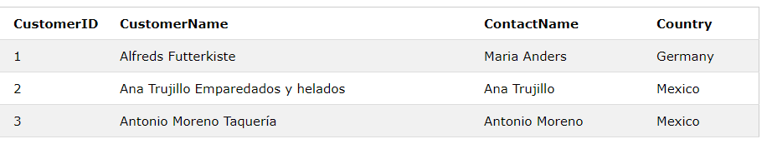
INNER JOIN
ORDERS TABLE CUSTOMERS TABLE

Slide 5
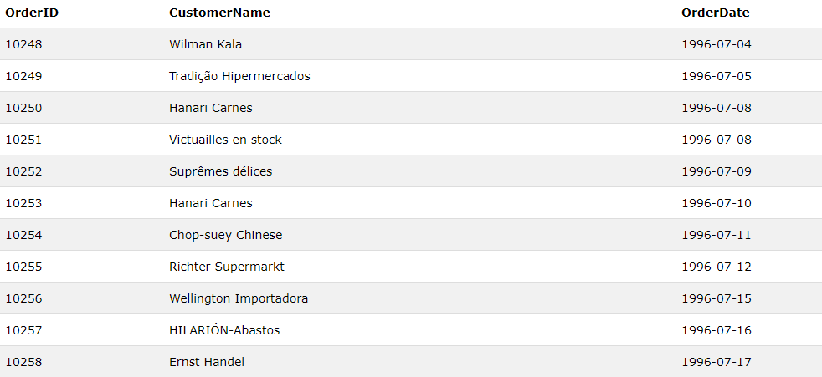
INNER JOIN QUERY
SELECT Orders.OrderID,Customers.CustomerName, Orders.OrderDate FROM Orders INNER JOIN Customers ON Orders.CustomerID=Customers.CustomerID;

Slide 6
TYPES OF JOINS
Here are the different types of the JOINs in SQL:
(INNER) JOIN:
LEFT (OUTER) JOIN
RIGHT (OUTER) JOIN
FULL (OUTER) JOIN
SELF JOIN
CROSS JOIN

Slide 7
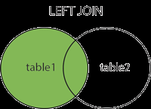
LEFT JOIN
The LEFT JOIN keyword returns all records from the left table (table1), and the matched records from the right table (table2). The result is NULL from the right side, if there is no match.
In some databases LEFT JOIN is called LEFT OUTER JOIN.

Slide 8
LEFT JOIN SYNTAX
SELECT column_name(s)
FROM table1
LEFT JOIN table2
ON table1.column_name = table2.column_name;

Slide 9
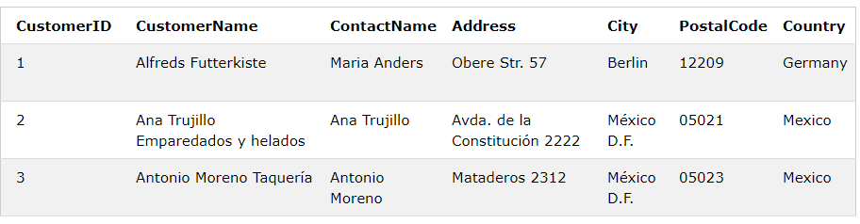
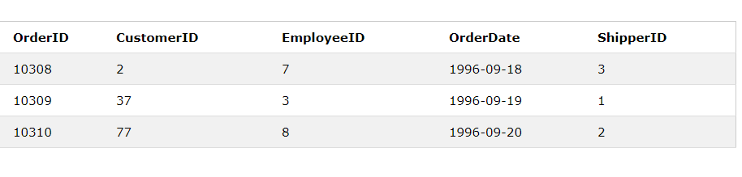
LEFT OUTER JOIN
CUSTOMERS TABLE ORDERS TABLE

Slide 10
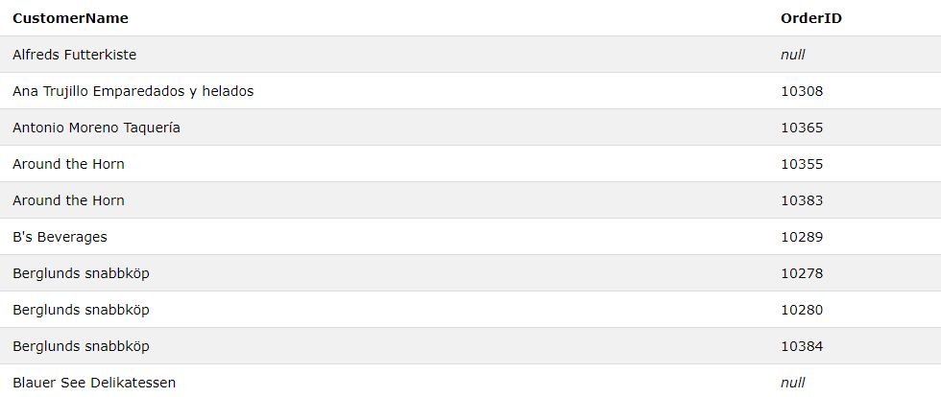
LEFT OUTER JOIN
SELECT Customers.Companyname, Orders.OrderID
FROM Customers
LEFT JOIN Orders ON Customers.CustomerID = Orders.CustomerID
ORDER BY Customers. Companyname;

Slide 11
LEFT OUTER JOIN
The LEFT JOIN keyword returns all records from the left table (Customers), even if there are no matches in the right table (Orders).

Slide 12
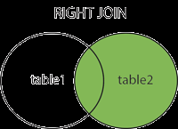
SQL RIGHT JOIN KEYWORD
The RIGHT JOIN keyword returns all records from the right table (table2), and the matched records from the left table (table1). The result is NULL from the left side, when there is no match.
In some databases RIGHT JOIN is called RIGHT OUTER JOIN.

Slide 13
RIGHT JOIN SYNTAX
SELECT column_name(s)
FROM table1
RIGHT JOIN table2
ON table1.column_name = table2.column_name;

Slide 14
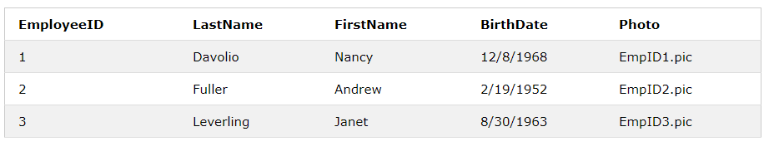
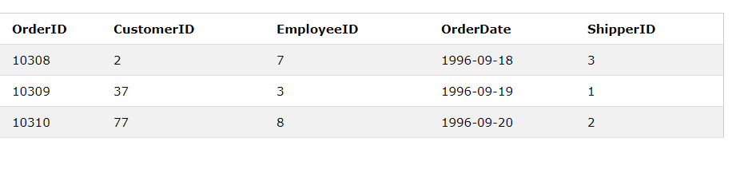
RIGHT JOIN
ORDERS TABLE EMPLOYEES TABLE

Slide 15
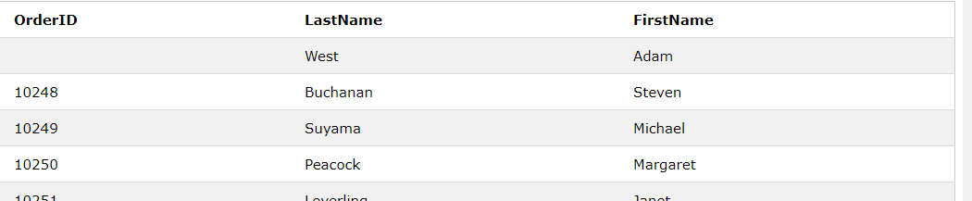
RIGHT OUTER JOIN
SELECT Orders.OrderID, Employees.LastName, Employees.FirstName
FROM Orders
RIGHT JOIN Employees ON Orders.EmployeeID = Employees.EmployeeID
ORDER BY Orders.OrderID;

Slide 16
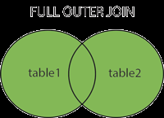
SQL FULL OUTER JOIN KEYWORD
The FULL OUTER JOIN keyword return all records when there is a match in either left (table1) or right (table2) table records.
FULL OUTER JOIN can potentially return very large result-sets!

Slide 17
FULL OUTER JOIN SYNTAX
SELECT column_name(s)
FROM table1
FULL OUTER JOIN table2
ON table1.column_name = table2.column_name;

Slide 18
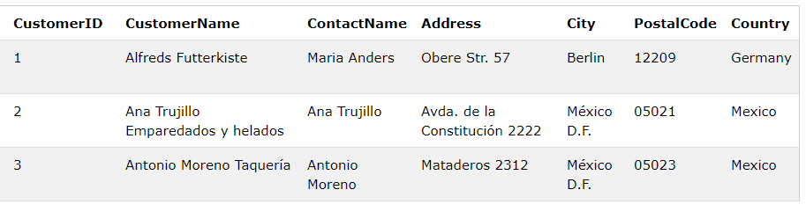
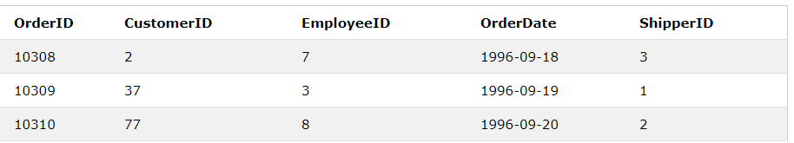
FULL OUTER JOIN
CUSTOMERS TABLE ORDERS TABLE

Slide 19
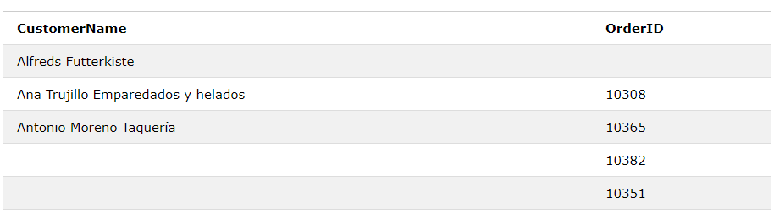
SQL FULL OUTER JOIN
SELECT Customers.CustomerName, Orders.OrderID
FROM Customers
FULL OUTER JOIN Orders ON Customers.CustomerID=Orders.CustomerID
ORDER BY Customers.CustomerName;

Slide 20
SQL SELF JOIN
A self JOIN is a regular join, but the table is joined with itself.
SYNTAX
SELECT column_name(s)
FROM table1 T1, table1 T2
WHERE condition;

Slide 21
SELF JOINS
A self-join is a query in which a table is joined (compared) to itself.
Self-joins are used to compare values in a column with other values in the same column in the same table.

Slide 22
SELF JOIN Example
Which customers are located in the same state (column name is Region)?
SELECT DISTINCT c1.ContactName, c1.Address, c1.City, c1.Region FROM Customers AS c1, Customers AS c2 WHERE c1.Region = c2.Region AND c1.ContactName <> c2.ContactName ORDER BY c1.Region, c1.ContactName;

Slide 23
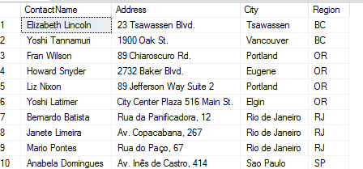
SELF JOIN EXAMPLE RESULT

Slide 24
EXERCISE
Which customers are located in the same city?
Notes:
32 ROWS

Slide 25
SELF JOIN USAGE
You use a self join when a table references data in itself. E.g., an Employee table may have a SupervisorID column that points to the employee that is the boss of the current employee.
It's basically used where there is any relationship between rows stored in the same table.

Slide 26
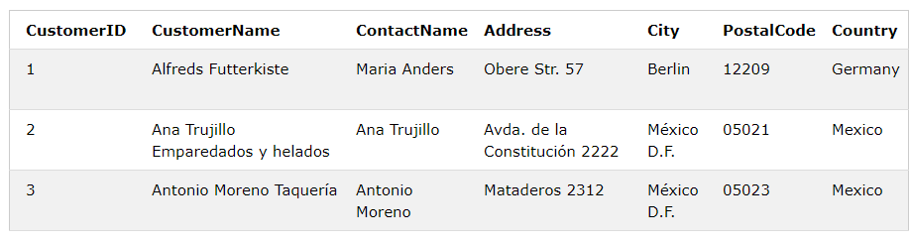
SELF JOIN
Customers table

Slide 27
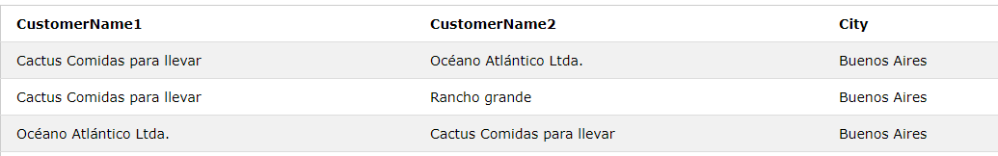
SELF JOIN EXAMPLE
SELECT A.CustomerName AS CustomerName1, B.CustomerName AS CustomerName2, A.City
FROM Customers A, Customers B
WHERE A.CustomerID <> B.CustomerID
AND A.City = B.City
ORDER BY A.City;

Slide 28
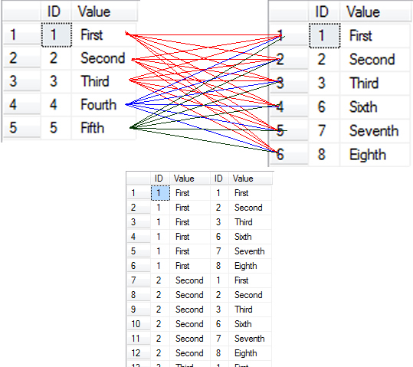
CROSS JOIN
This returns the Cartesian product of rows from tables in the join. In other words, it will produce rows which combine each row from the first table with each row from the second table

Slide 29
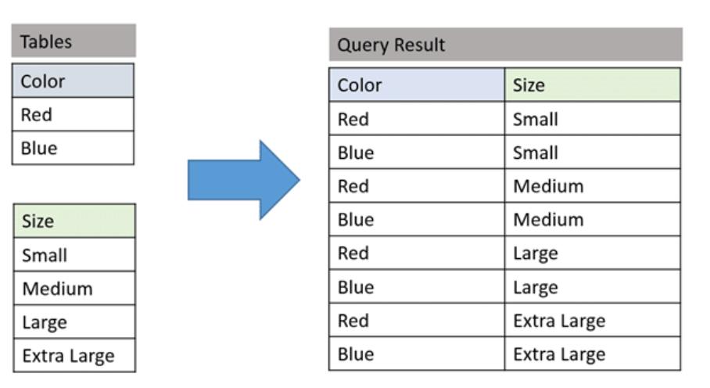

Slide 30
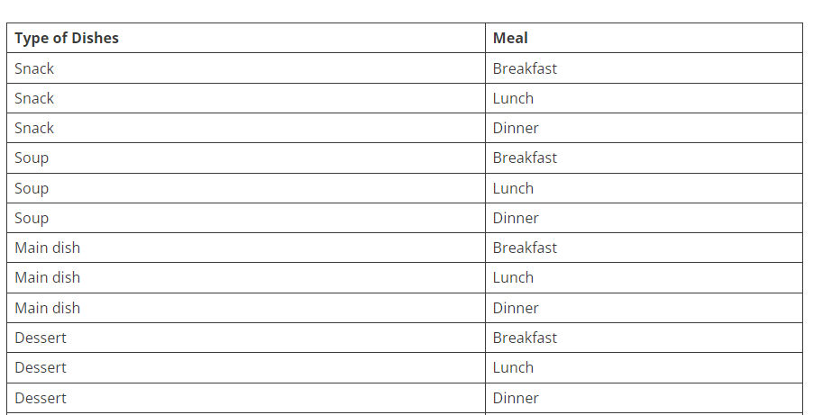

Slide 31
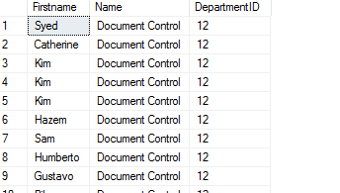
CROSS JOIN EXAMPLE
select p.Firstname, d.Name,d.DepartmentID
from person.Person p
cross join HumanResources.Department d

Slide 32
Display Product Name and its Category Name where Category Name starts with B (Hint: Left join category and product, use wild card)
Display Titles and their quantity (Hint Pubs database, table title and sales, left join)
Use Right join to display Book Title and publisher Names (Hint pubs Database, Table Title and Publisher) Write down the reason for any null values if coming in title column.
User Right join to display those publishers where title is null.
Use self-join to display Publishers name where city is same (Publisher id should be different) Sample example

Slide 33

6. Use cross join (Cartesian join) to Display Book Title and Publisher Name.
7. Use two full joins to Display Product Name, Category Name and Supplier Name (Hint: Below Example)
Example:
select col1 ,col2 ,col3
from table supplier
full join table product
on supplier.productid=product.productid
full join Categories
on product.CategoryID=category.CategoryID
8. Use full join to display the name of Supplier for the product starting with letter C (Hint: Northwind)
9. Get shipper’s Company Name for an order using inner join. (Display only orderID from orders and comapnayName from Customers table)

Slide 34
tasks
10. Count no of Products’s against each suppliers name. list only those products whose count is greater than 3
11. Display Region ID, Region Description, Territories Description and (inner join with table Territories and Region)
12. Display Company Name and Total orders placed by the company (Table: orders, customer, use inner join, group by)

